Slide 1
The Mainstreaming of the 2030 Agenda Approach in the Planning and Budgeting Processes

Slide 2
Two enabling elements for a coordinated integration of the 2030 Agenda:
The country’s institutional architecture.
The institutional dialogue with government ministries equipped with transversal attributions (example: Ministry of Finance).

Slide 3
Institutional architecture

Slide 4
Institutional architecture
National Strategic Plan
Linkages between instruments
Logical Framework Approach
Complimentarity 2030 Agenda & National Planning System
Sectoral programmes
Transversal Programmes
Special, institutional & regional programmes
Budget programmes

Slide 5
Permeability
Sustainable Development Goals
National Planning
Programmatic Structure
Budget
17
SDGs
169
Targets
230
Indicators

Slide 6
Budget contribution to the SDGs and targets

Slide 7
Budget contribution to the SDGs and targets
Coincidence analysis between SDGs targets and National Goals 2013-2018 through their strategies and allocations.
SDGs Targets
National Goals Strategies
2013-2018
Carried out by the Ministry of Finance, UNDP and the President´s Office

Slide 8
Budget contribution to the SDGs and targets
Goal
Provide more information on the relevance and pertinence of public investments for development, through a thorough analysis of resource allocations.
Provide inputs for planning and programming improvements.
Participatory methodologies with government agencies.
Linkage guidelines (methodology)
PHASE I
Identification of linkages between budgetary programmes and SDGs
PHASE II
Refinement of the analysis
1. Subtargets;
2. Target population;
3. Kinds of contributions (direct/indirect).

Slide 9
Budget contribution to the SDGs and targets
National Development
Plan
Budget Program
1
Budget Program
n
Each program with maximum 6 goals
18 indicators by program (max. three by goal).
National Targets
Transversal
Strategies
Transversal
Program
Sectorial
Program 1
Related Indicators
Budget Program
1
Budget Program n
Sectorial
Program N
Budget Program
1
Budget Program
n
- Programmatic Structure
based in budgetary
programs

Slide 10
Budget identification
1
Budget universe
Programmable spending.
Autonomous sectors are excluded.
2
Definition of analysis unit
To identify the budget that contributes to the SGDs, the analysis is based on the budgetary program.

Slide 11
A methodology to link SDGs and budgets
SDGs – Budget program
linking
Contribution of Budget to SDGs
Coincidence analysis SDG targets → National Planning
Budget program integration
Budget program related to targets
Identification/
confirmation
Identification/
confirmation

Slide 12
Budget identification
3
Sub targets definition
When the SDGs targets are wide, we divide them in sub targets. (45 sub targets in 169 targets).
Example:
Target 1.4. By 2030, ensure that all men and women, in particular the poor and the vulnerable, have equal rights to economic resources, as well as access to basic services, ownership and control over land and other forms of property, inheritance, natural resources, appropriate new technology and financial services, including microfinance.

Slide 13
Budget identification
4
Types of contribution
a. Budget contributes to achieve the target or sub target is Direct.
b. Budget can generate conditions to achieve target or sub targets despite that target or sub targets is not the principal goal of the budget program – Indirect.

Slide 14
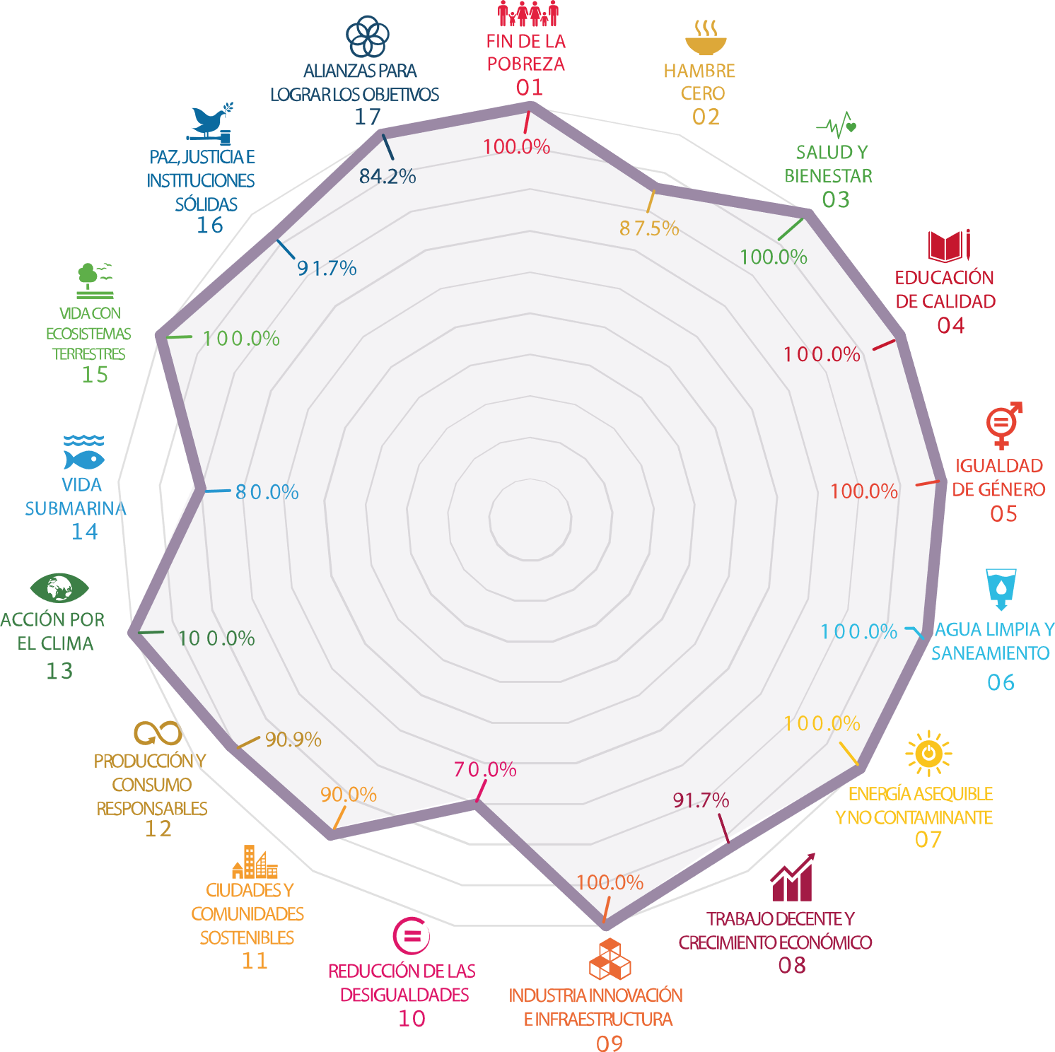
Results: % of linked targets
- 584 budgetary programs were analyzed
- 486 budgetary programs linked to the 2030 Agenda (83.2%)

Slide 15
Results: % of linked targets
LINKAGES

Slide 16
From thematic contribution to quantification
How can we split budgets units when they directly and indirectly contribute to various targets?
Prospera Program
15 linkages
6 direct and 8 indirect

Slide 17
Lessons learnt
Mainstreaming the 2030 Agenda ≠ Plans and budgets directly derived from the SDGs
Countries priorities are first. SDGs Agenda is a theorical and methodological framework to support them
It is determining to observe the pertinent planning/budgeting unit
A human and qualitative appreciation is necessary
The purpose of a contribution analysis is not necessarily to identify the invested amount for each SDG
Budget allocation ≠ A public issue is addressed
A review of all the stages of the public policy cycle and complementary methodologies are needed

Slide 18
A practical guide to the Mainstreaming of the 2030 Agenda Approach
A practical guide to the Mainstreaming of the 2030 Agenda Approach
For every sector
For every level of government

Slide 19
The 2030 Agenda Approach through the Policy Cycle
Diagnosis
Design
Implementation
Monitoring
Evaluation
The vision and principles of the 2030 Agenda:
INTEGRATED APPROACH
HUMAN RIGHTS
LEAVE NO ONE BEHIND
The result-based management for development.
Monitoring and evaluation processes.
Participatory methodologies.
Partnerships.

Slide 20
Notes:
Not an incremental but a transformative approach
Simple but worng vs complex but right
Increase resources for: mobilized, delivered, leveraged
Delicate to speak about alignment – we prefer maintreaming
Value of mapping

